Slide 1






Kickoff Colloquium
September 1, 2010

Slide 2
Brain Teaser 1

Slide 3


Brain Teaser 2
x₀< x₁
1. Alice chooses two reals by an unknown process
xb
2. Bob chooses a uniformly random bit b
x_{b}
Your goal: guess b with probability better than 50%
3. You get only x_{b}

Slide 4
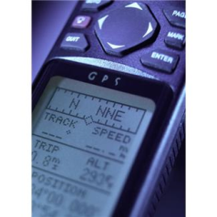
What’s the Problem?
Wallpaper apps on Android Market are found to be gathering phone numbers, subscriber ID, etc, and transmitting to an unknown server registered in China
Thieves steal your car and GPS and use it to find your home, stealing your other car
Hackers plant malware in Windows Mobile games that make expensive calls to Somalia

Slide 5
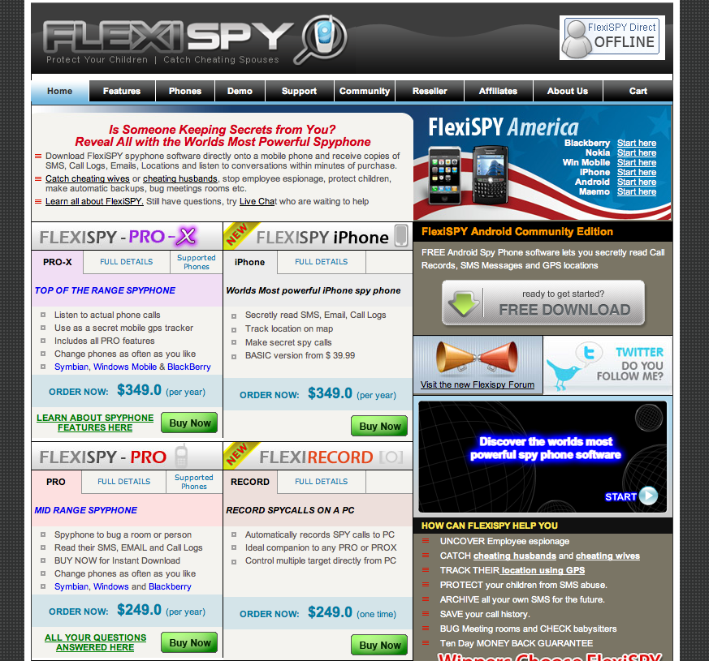

Slide 6
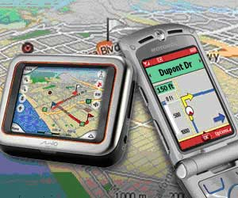
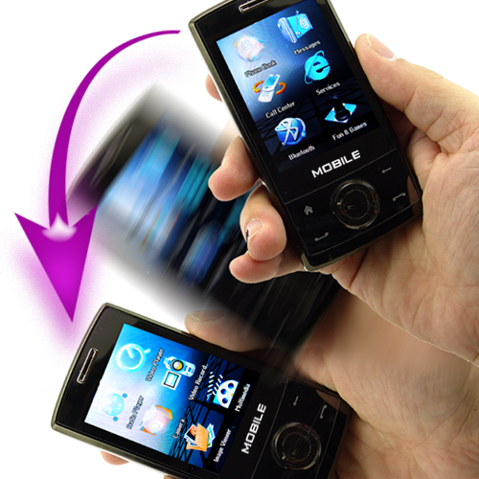

Softphone
Mini laptop/netbook
+….
Powerful sensors
Motion (Accelerometer)
Location (GPS)
Camera
Microphone
Compass

Slide 7
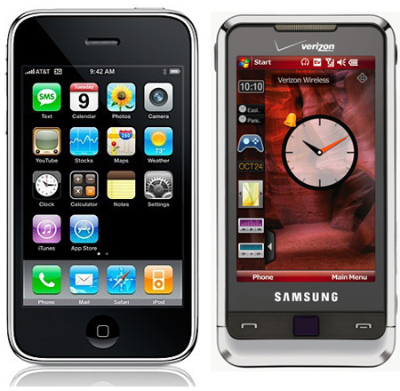
How bad could it get?
Bring down 911 systems?
Blind air traffic control?
Facilitate espionage?
Friend or Foe?

Slide 8


What’s the good news?
We have an opportunity for clean-slate development of softphone security
Softphone platforms are nascent and relatively fluid architecturally
New modalities to leverage in support of security
  Physical proximity
  Mobility
  Rich sensor data stream

Slide 9

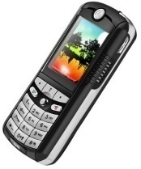
Overview
User Security and Privacy
System Security
Attacks on the Hardware
Attack Detection
Authentication
Protecting User Privacy
Incentives

Slide 10
User Security and Privacy
Attacks on the Hardware
  Securing the Hardware
    Avoid creating side channels, design of hardware with built-in attack detection – M. Karpovsky
  Hardware Hardened Modules
    Preventing side channel leakage – L. Reyzin
  Managing Leakage
    Exposure-resistant cryptography – L. Reyzin
Protecting User Privacy
    Secure, distributed sensing – N. Triandopoulos

Slide 11
User Security and Privacy
Leveraging Sensing to Authenticate
  Sensor-Based
    Sensor-generated secrets – L. Reyzin
  Proximity-Based
    Sensor-based proximity verification – L. Reyzin, D. Starobinski, and A. Trachtenberg

Slide 12
System Security
Attack Detection
  Physical Layer, esp SDR
    Analyzing SDR threats – M. Crovella, D. Starobinski,
    G. Troxel
  Statistical Attack Detection
    Crowd-sourced attack detection – M. Crovella
Advanced Authentication
  Code authentication
    Resilient over-the-air programming – A. Trachtenberg and D. Starobinski
  Data authentication
    Distributed data authentication – N. Triandopoulos

Slide 13
System Security
Economics
  Economics and security impact of spectrum management
    D. Starobinski
  Incentive-compatible traffic control
    Protocol design – S. Goldberg
  Economic approach to unwanted traffic
    Attention bonds for spam suppression – S. Homer

Slide 14
A Unique Team
All nine of the principal investigators are faculty members at Boston University
  Very rare to have such a broad and deep collection of expertise under one roof
Cross-cutting collaboration between
  Computer Science,
  Electrical and Computer Engineering, and
  Metropolitan College Computer Science

Slide 15
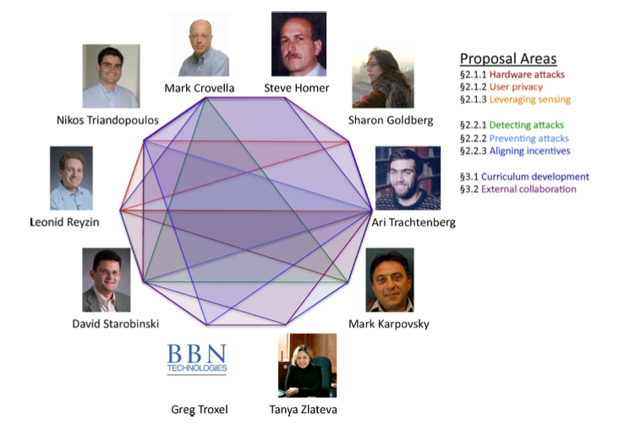
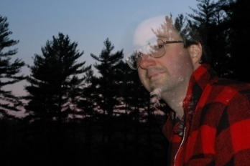

Slide 16


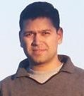
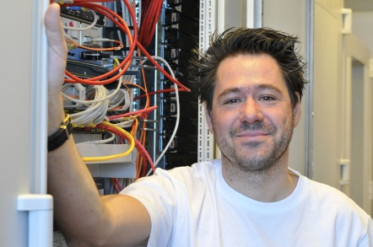
Collaborators
Raytheon BBN Technologies
  Experts in software defined radio
University of Warwick
  Digital forensics, malware propagation, formal modeling
Deutsche Telekom
  Major handset vendor (T-Mobile) and network service provider
  Extensive security experience

Slide 17
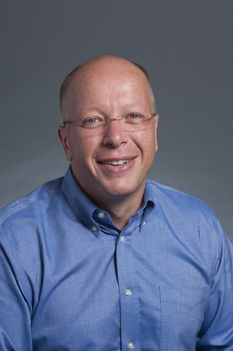
Mark Crovella
Research Interest
Performance evaluation
Parallel and networked computer systems
Internet measurement and modeling
Self-similarity and heavy-tailed distributions in network traffic
Professor
Computer Science Department
College of Arts and Sciences
http://www.cs.bu.edu/fac/crovella

Slide 18
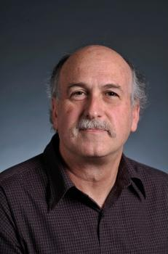
Steven Homer
Research Interest
Theoretical computer science
Complexity theory
Quantum computing
Learning theory
Parallel and probabilistic algorithms
Professor
Computer Science Department
College of Arts and Sciences
http://www.cs.bu.edu/fac/homer

Slide 19
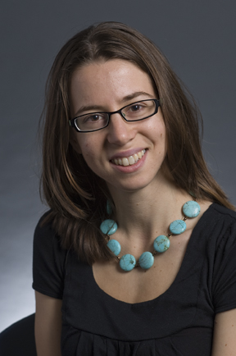
Sharon Goldberg
Research Interest
Network Security
Assistant Professor
Computer Science Department
College of Arts and Sciences
http://www.cs.bu.edu/fac/goldbe

Slide 20
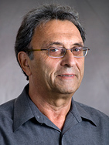
Mark Karpovsky
Research Interest
Design of secure cryptographic devices and smart cards
Routing in interconnection networks design and protection of cryptographic devices
Fault-tolerant computing
Error correcting codes
Testing and diagnosis of computer hardware
Professor
Electrical and Computer Engineering
College of Engineering
http://mark.bu.edu

Slide 21
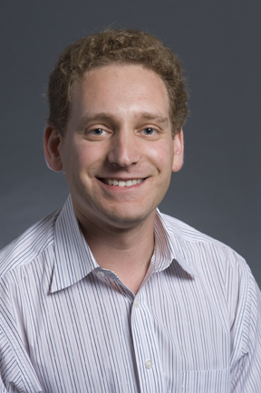
Leonid Reyzin
Research Interest
Cryptography
Associate Professor
Computer Science Department
College of Arts and Sciences
http://www.cs.bu.edu/fac/reyzin

Slide 22
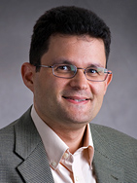
David Starobinski
Research Interest
Wireless networking and security
Network economics
Stochastic Processes
Algorithms
Associate Professor
Electrical and Computer Engineering
College of Engineering
http://people.bu.edu/staro

Slide 23
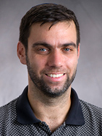
Ari Trachtenberg
Research Interest
Error correcting codes
Security and algorithms
Data synchronization
Location detection
Sensors, PDAs, smartphones
Associate Professor
Electrical and Computer Engineering
College of Engineering
http://people.bu.edu/trachten

Slide 24
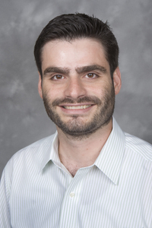
Nikos Triandopoulos
Research Interest
Information Security & Privacy
Network Security
Distributed System Security
Secure Protocol Design
Research Assistant Professor
RISCS Center and Computer Science
http://www.cs.bu.edu/~nikos

Slide 25
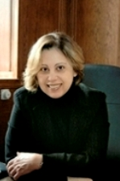
Tanya Zlateva
Research Interest
Computational Modeling of Visual Perception, Recognition, Three Dimensional
Representations of Object Shape, Parallel and Distributed Processing
Associate Professor
Computer Science Department
Metropolitan College
http://people.bu.edu/zlateva

Slide 26

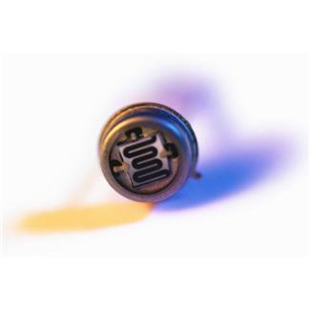
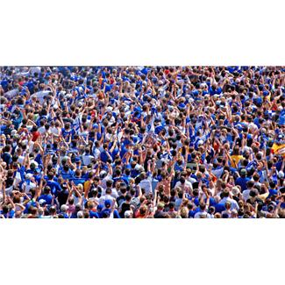
Integrated Security
Economics
  Metadata (MC)
  Cost for inconvenience (DS)
Hardware
  High costs for security (MK)
  Can sensor mitigate costs? (AT)
Network and System Level
  Crowdsourcing anomaly detection (MC)
  Smartphone as a sensor network (DS)
  Software-defined radios (GT)
Notes:
Economics: metadata and cost for inconvenience
Hardware: costs are very high – $100k certification + high power consumption how can we reduce them? Maybe using sensors.
Network: Smart phone as DTN – Relationship to social nets

Slide 27
The Promise of Ubiquitous
Communication and Computation
Unrestrained collaboration in groups large and small
Examples:
  Crime-reporting with protection from corruptible authorities (when police are potentially corrupt)
  Political organizing without (state-owned?) media filters
  Real-time traffic monitoring
  Disaster relief
Problems:
  How do you get valid information
  In a way that preserves individual privacy
  In a way that gives people a reason to participate
  (no privacy ⇒ no participation)
  (no validity ⇒ data pollution ⇒ no participation)

Slide 28
Privacy - more than confidentiality
a general concern, decomposable into
  confidentiality of contents of communication (TLS)
  freedom from traffic analysis (Tor for IP, ?)
  freedom from query analysis (private information retrieval)
  confidentiality of location (?)
  ? (?)
softphone-related particular challenges
  location, location, location!
  always-with-human and multifaceted (entertaintment/payment/work/play/love):
  surveillance like never before

Slide 29
Information Reliability & Integrity
Also a general concern with various aspects:
Validity of reports or shared information
  reputation-based, ground-truth checkable,…
User authentication
  using password, sensors, proximity, anonymous credentials,…
Reliable distributed data management
  p2p-based, best-effort vs. 100% accuracy,…
Dynamic group formation
  based on user registration/revocation, access controlled,…
Non-solution for any of the above:
  Register every cell phone to a name, punish for bad communication

Slide 30
What’s different
(given all this prior work)
Promises (not available on PCs):
  High mobility
  Opportunistic networking
  Rich sensing
  Always-on
  Peer-to-peer (wifi/bluetooth) and infrastructure mode
Challenges (not the same as PCs):
  Computing constraints (e.g., for evaluation of sensory data or running heavy protocols): memory, speed, power
  Fixed protocols at the phone network layer that are
  both privacy unfriendly and insecure
  Central control (large companies/government regulation) that may be unaligned with user incentives

